Slide 1

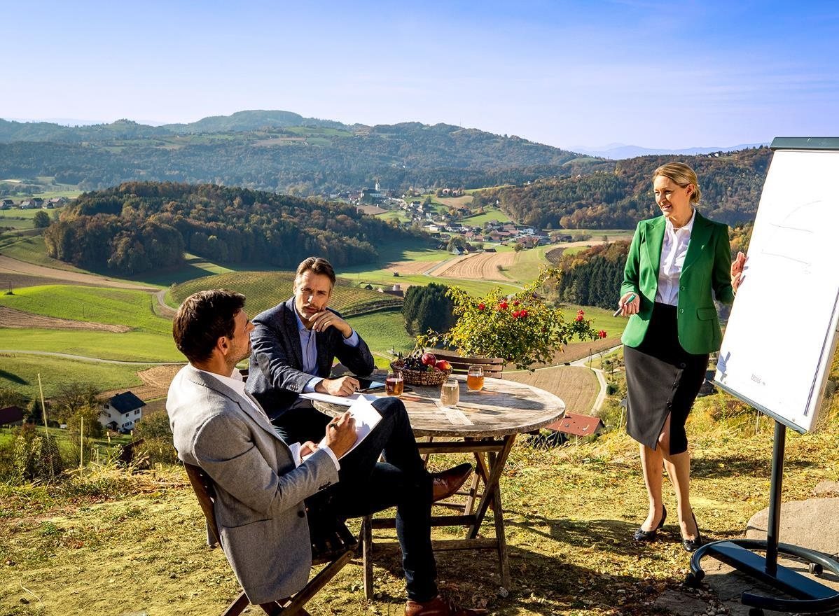

Steiermark Convention
Making meetings a delight
The Official
Convention Bureau of
Styria –
„The Green Heart of Austria“
steiermark.com/Convention

Slide 2

Styria
The Green Heart of Austria
A tourist brand for more than 50 years
Over 60% of the state's surface covered by forest
Sustainable by nature
steiermark.com/Convention

Slide 3
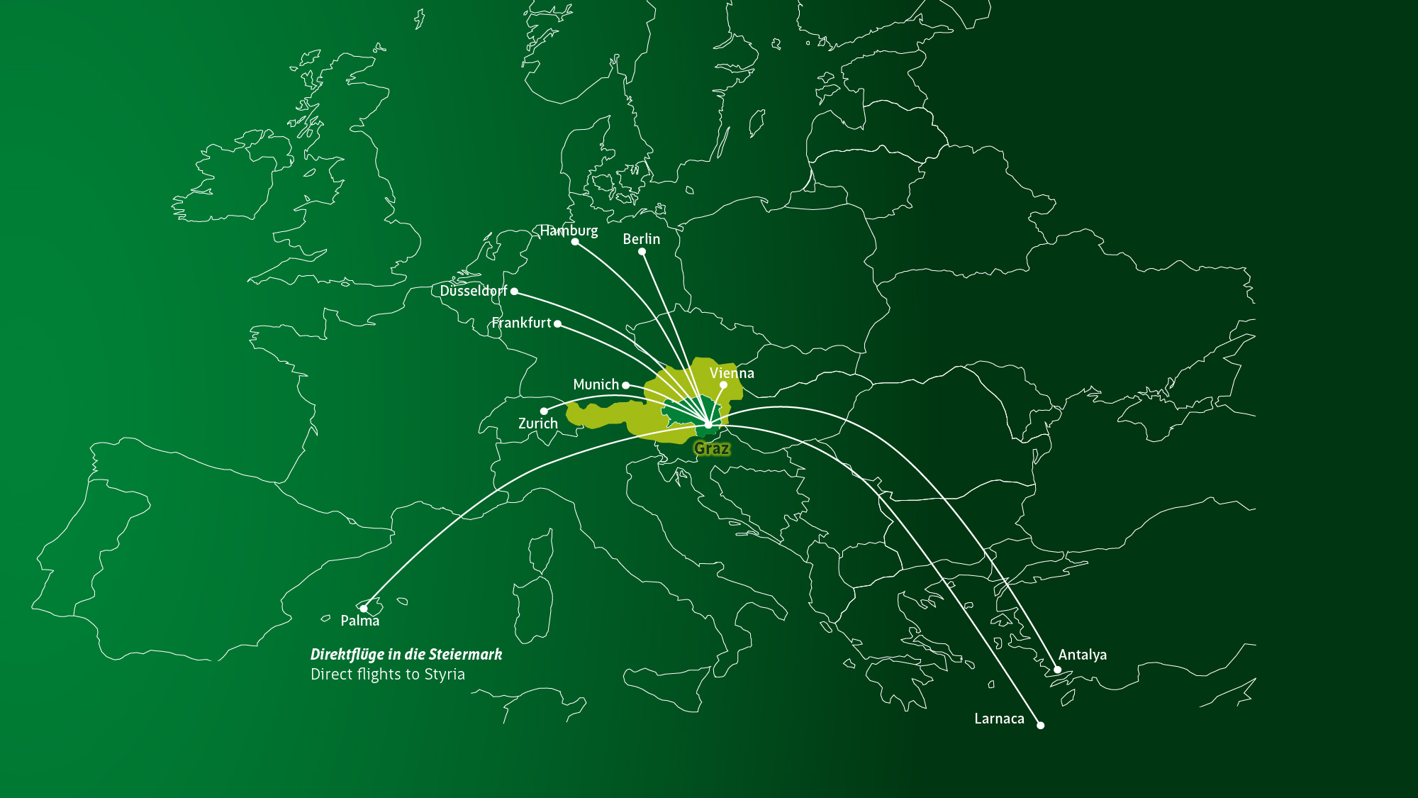
Steiermark
Accessibility

Slide 4
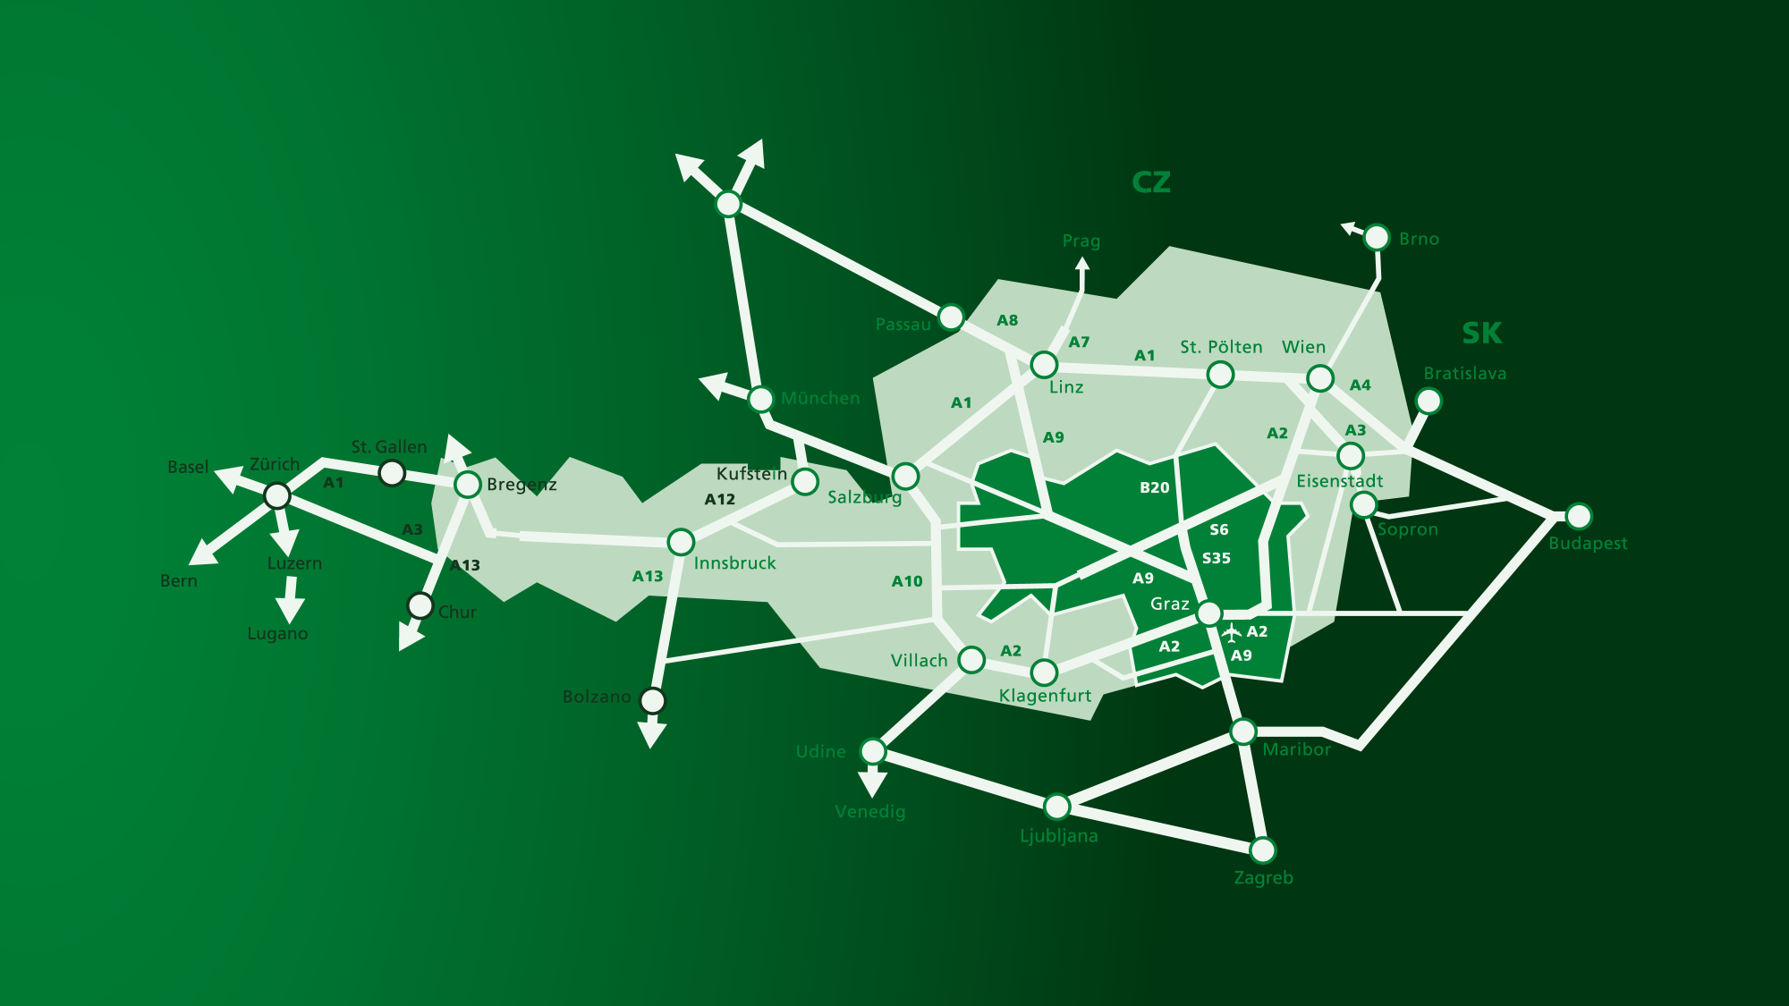
Steiermark
Location & directions

Slide 5
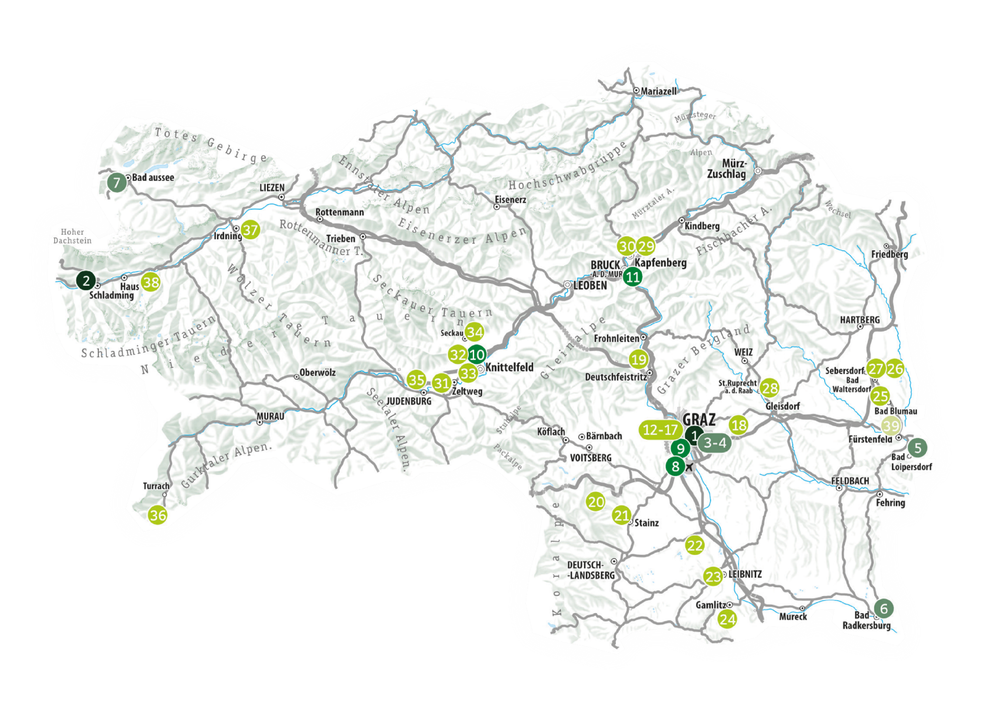
Steiermark
Regions & meeting locations

Slide 6
Styria
Worlds of experience
Eating & drinking
Nature & exercise
Wellness & regeneration
Culture in town and country
steiermark.com/Convention

Slide 7
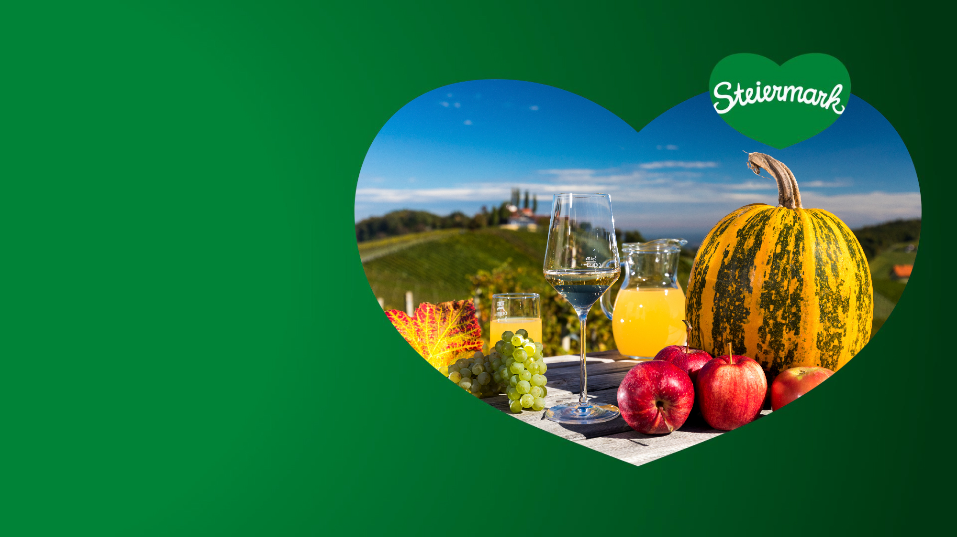
Styria
Eating & drinking
A destination with countless culinary highlights
Signature products:
The original pumpkin seed oil
Wine from the famous vineyards of Southern Styria
Apples from south and east Styria
Cheese from the traditional dairies of alpine Upper Styria
steiermark.com/Convention

Slide 8

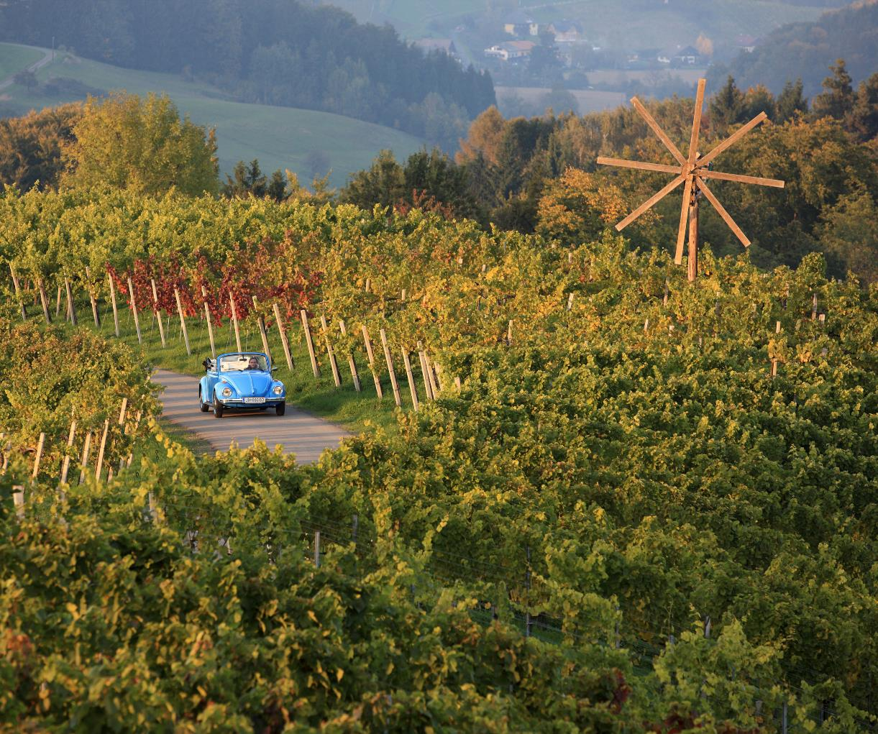
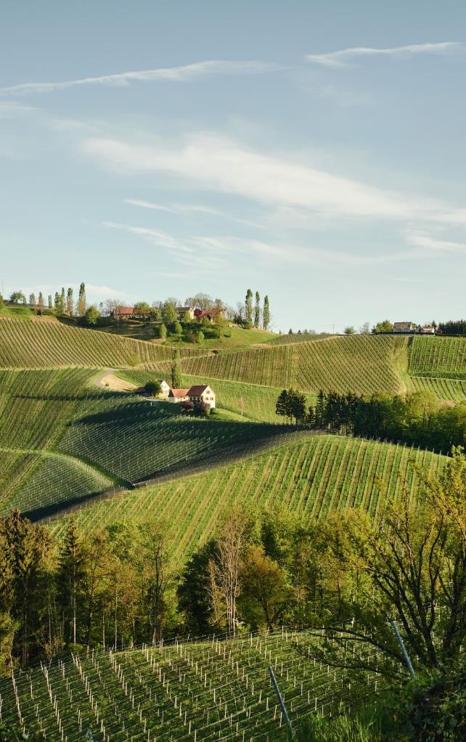

Southern Styria
The wine region

Slide 9
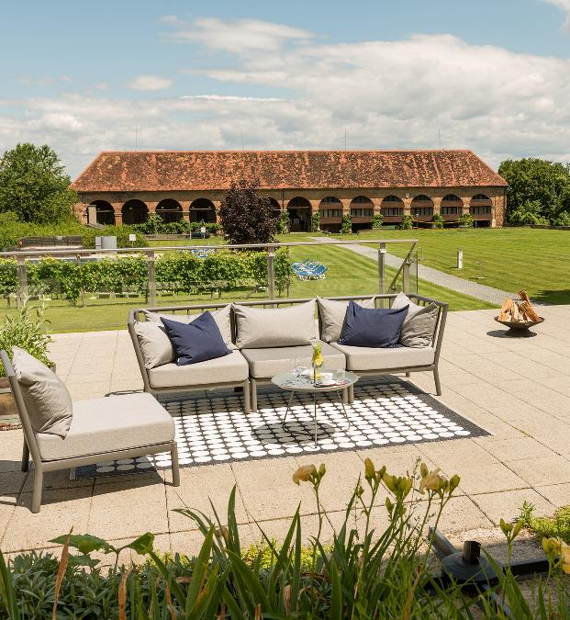
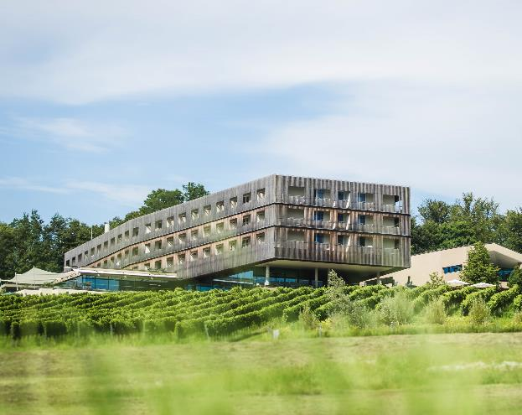
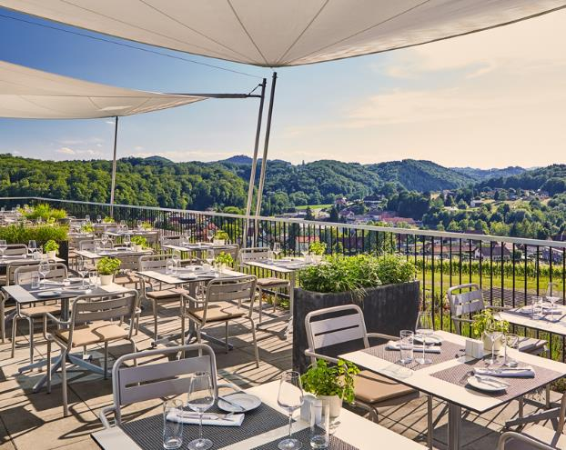
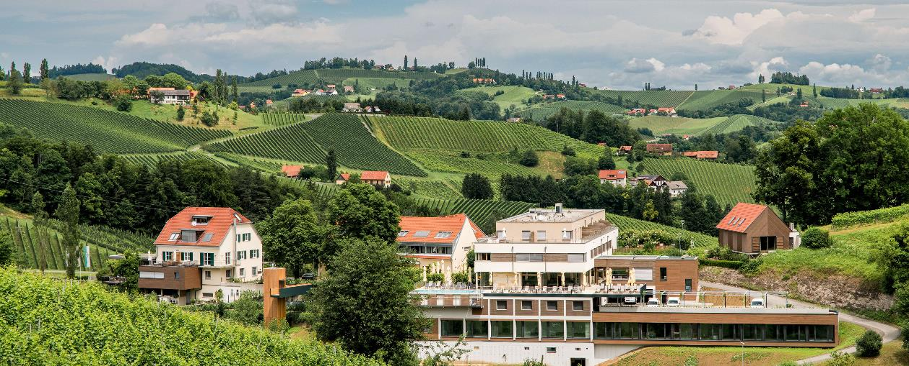
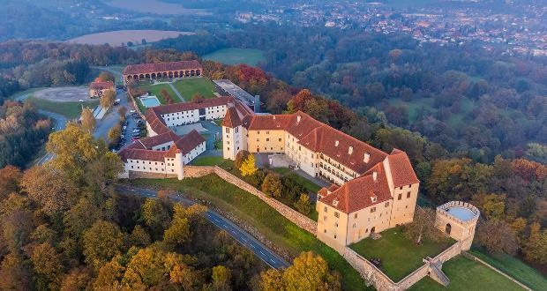

Slide 10
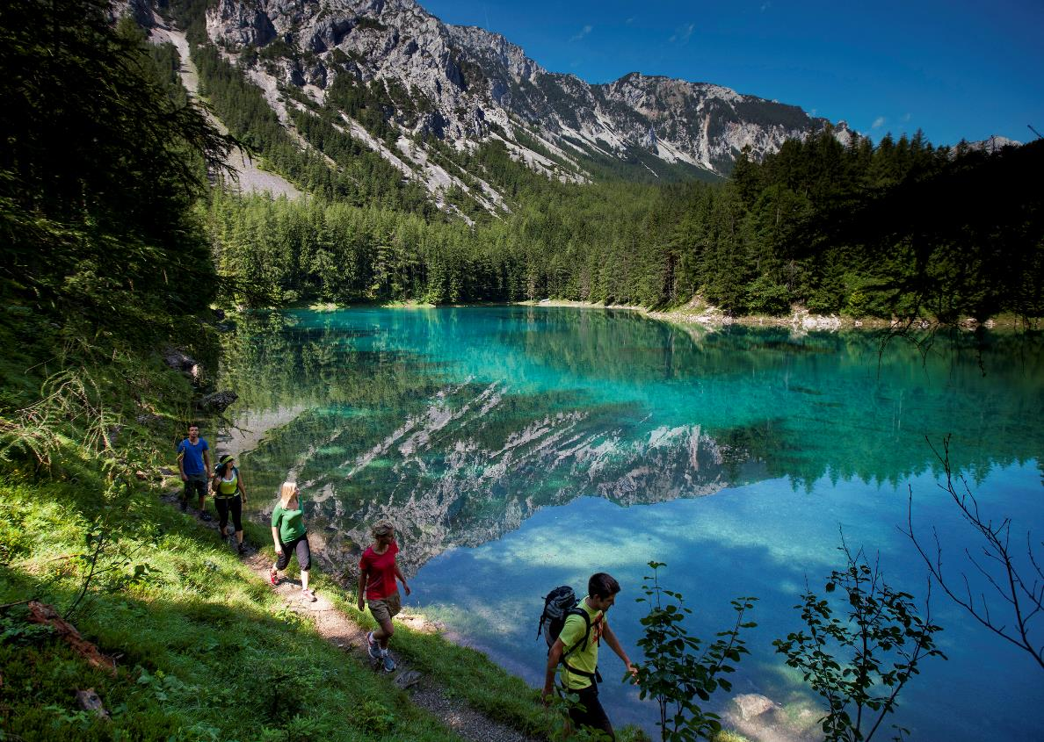
Styria
Nature & exercise
Experience nature & activities
on mountains, alpine meadows
& in forests:
Round off seminar days in breathtaking natural settings,
promote team building, recharge
your batteries for meetings
Multifaceted in the seasons: From cycling to hiking, from golfing and rafting to cross-country skiing and downhill skiing
Rich landscape from glaciers to wine

Slide 11
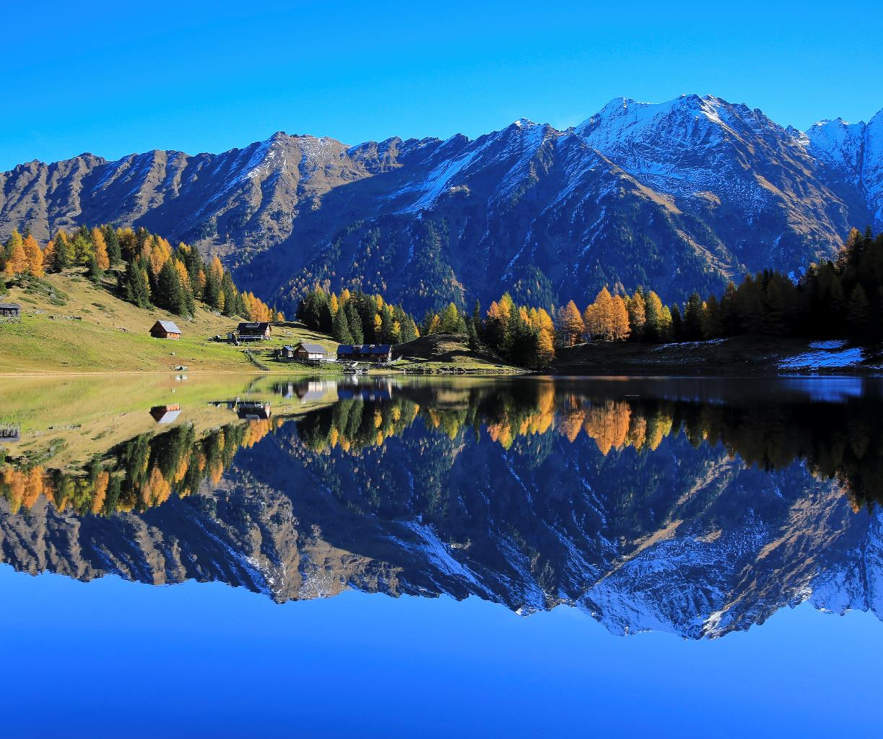
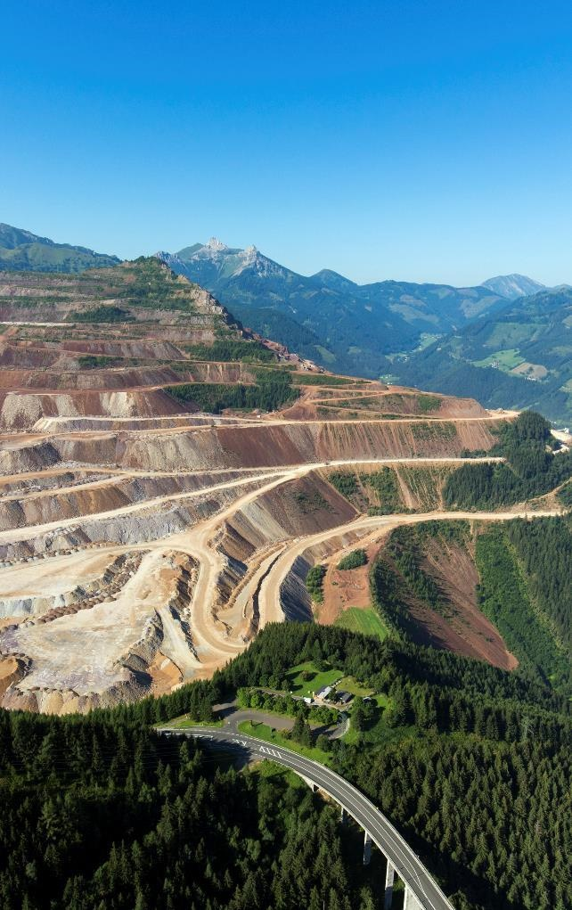
Upper Styria
The alpine regions

Slide 12
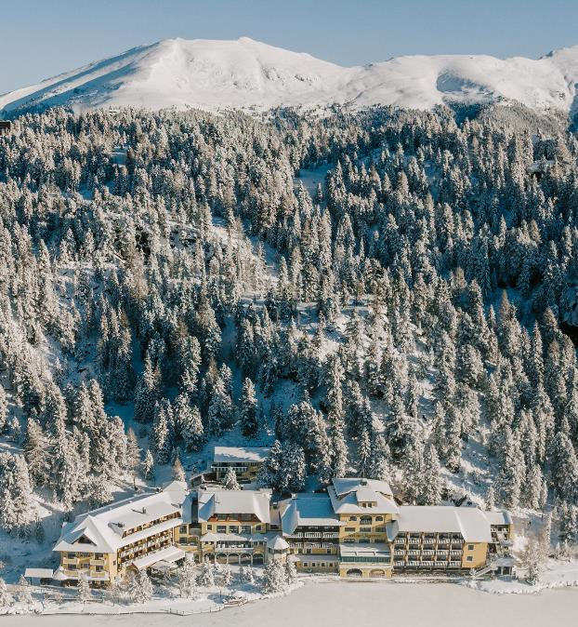
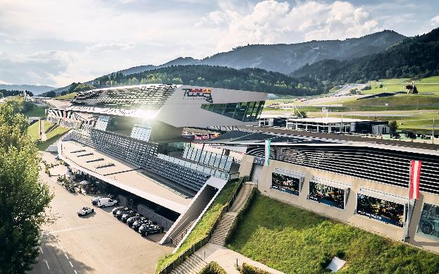
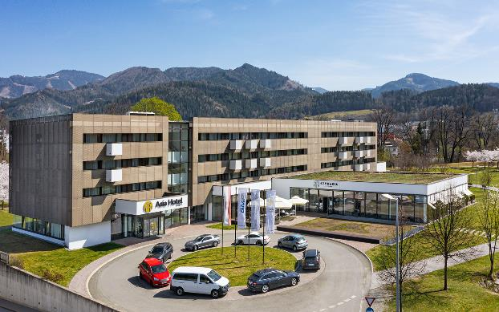
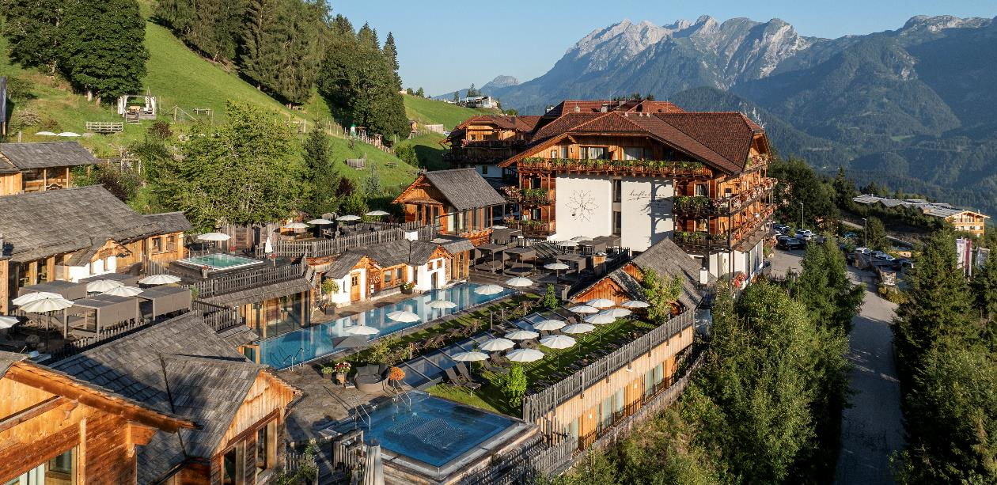
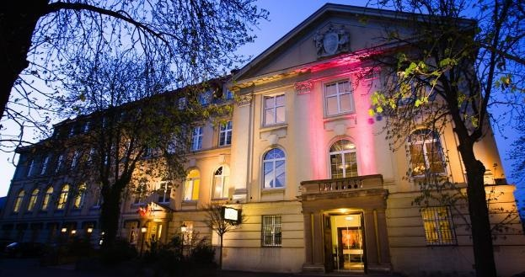

Slide 13
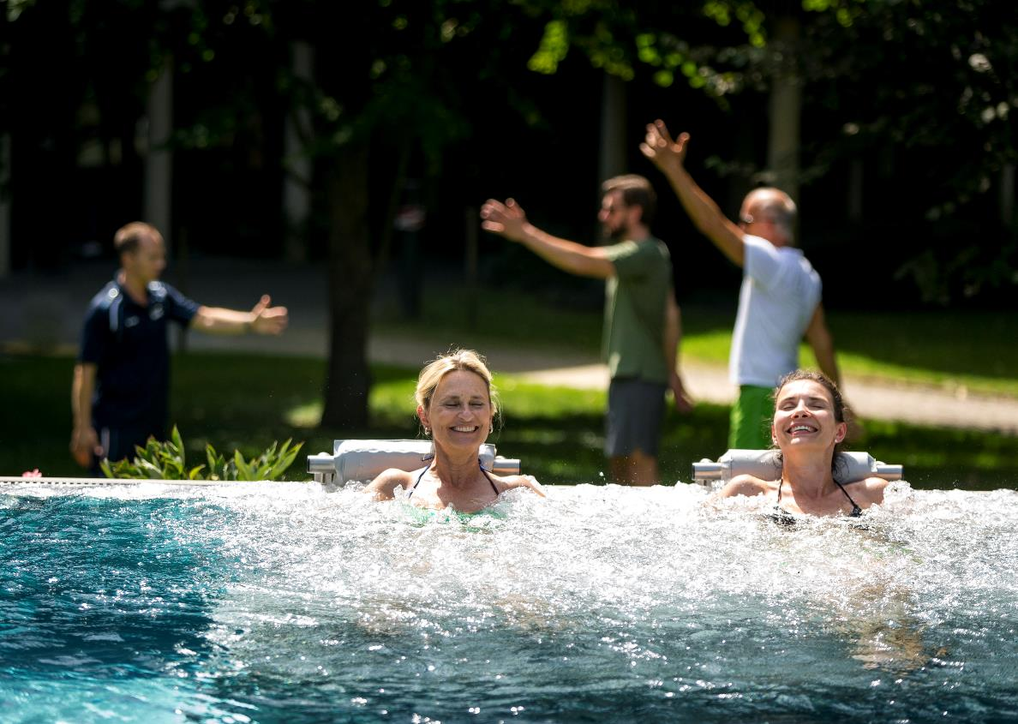
Styria
Wellness and regeneration
Styrian thermal springs promise regeneration & wellness for all senses:
Styrian thermal baths and spas offer a wide range of regeneration programmes for conference and congress guests
Well-being: 9 thermal spas and 17 health resorts for relaxation
The power of Styrian product treatments: From grape seeds to volcanic rock
steiermark.com/Convention

Slide 14
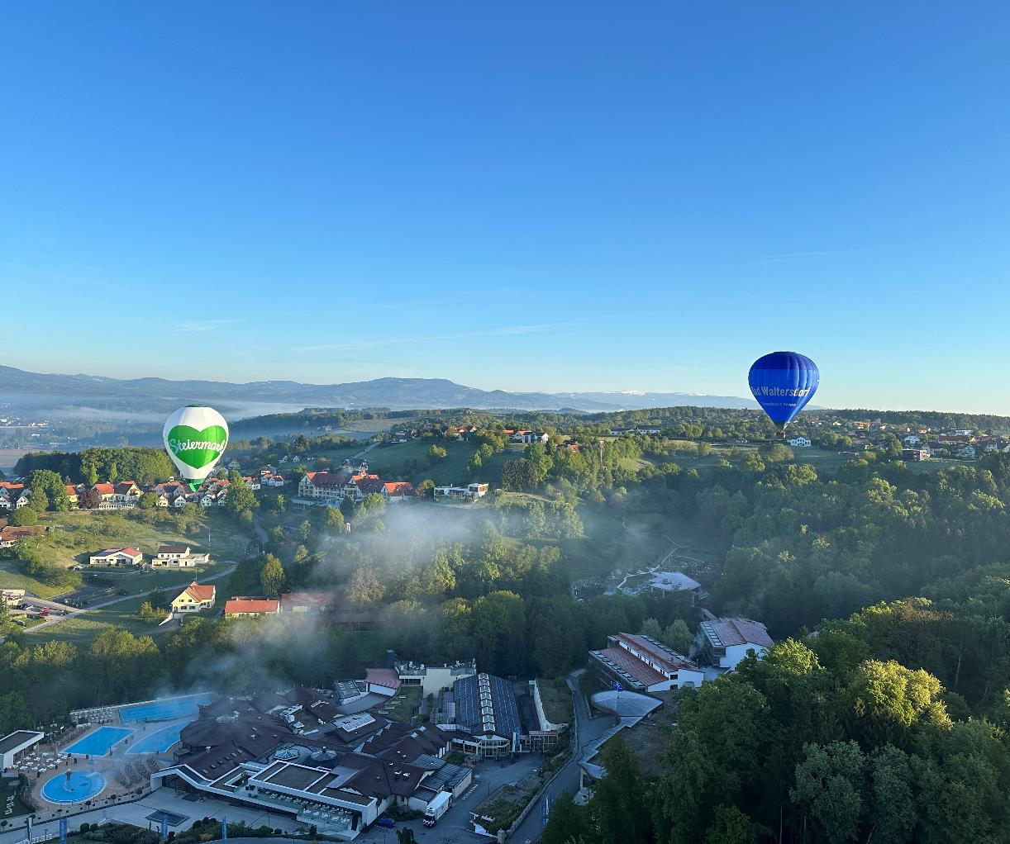
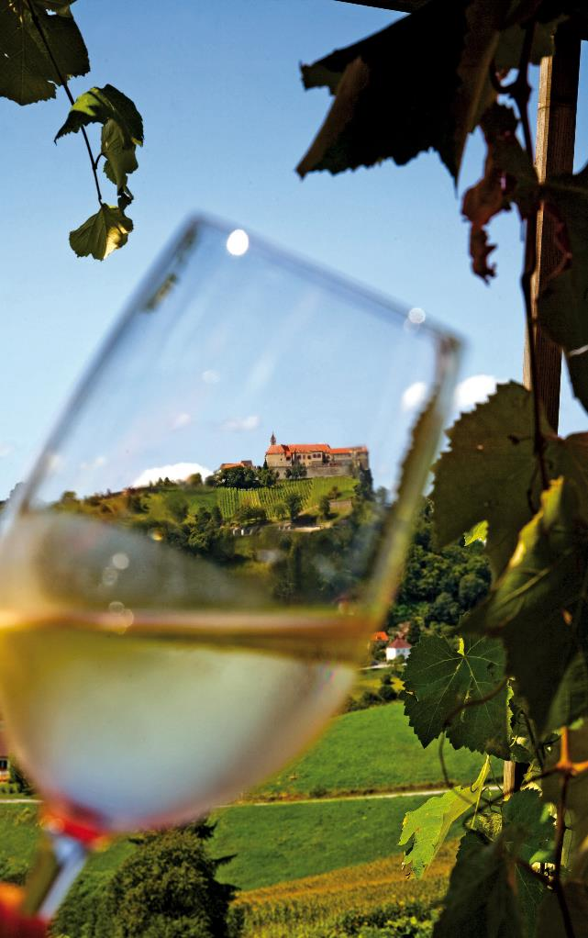
Eastern Styria
Vulkanland & thermal springs
Schladming-Dachstein
The alpine region

Slide 15
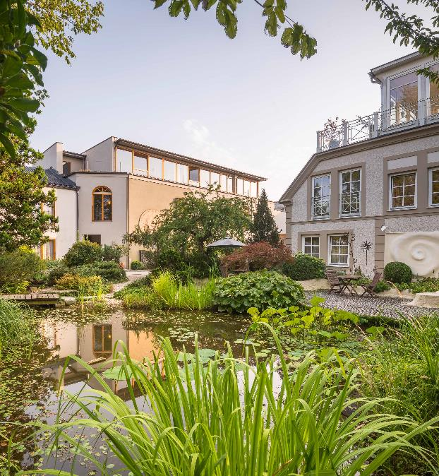
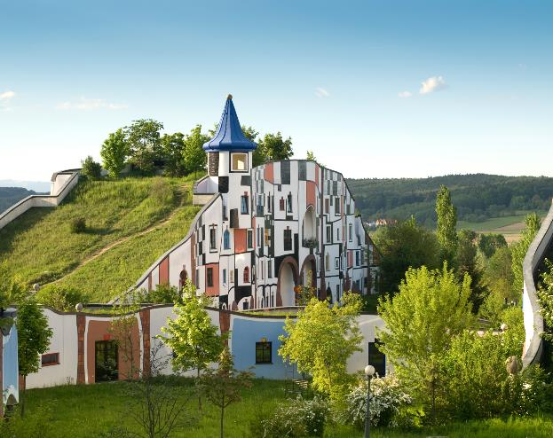
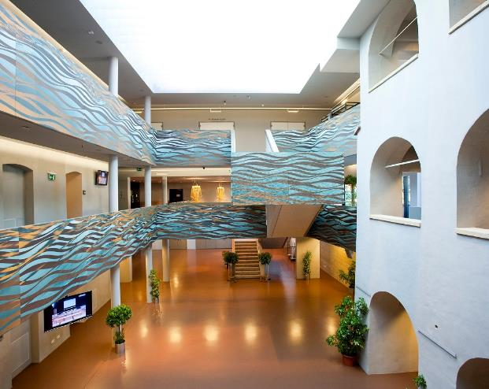
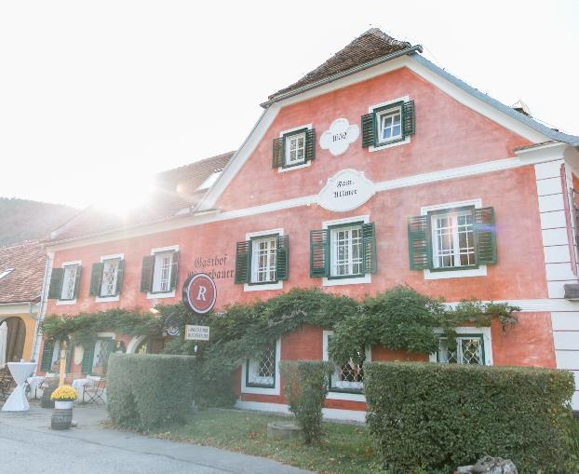
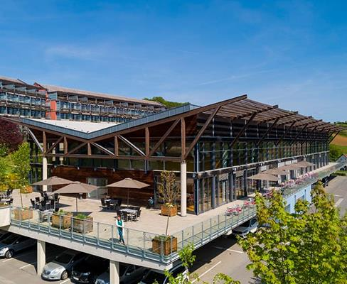
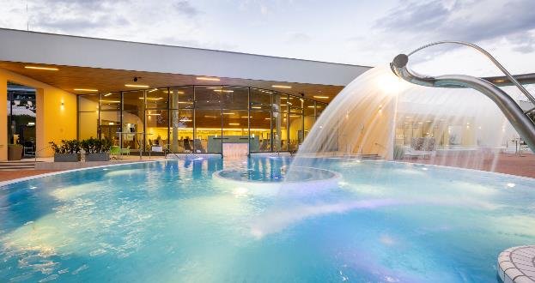

Slide 16
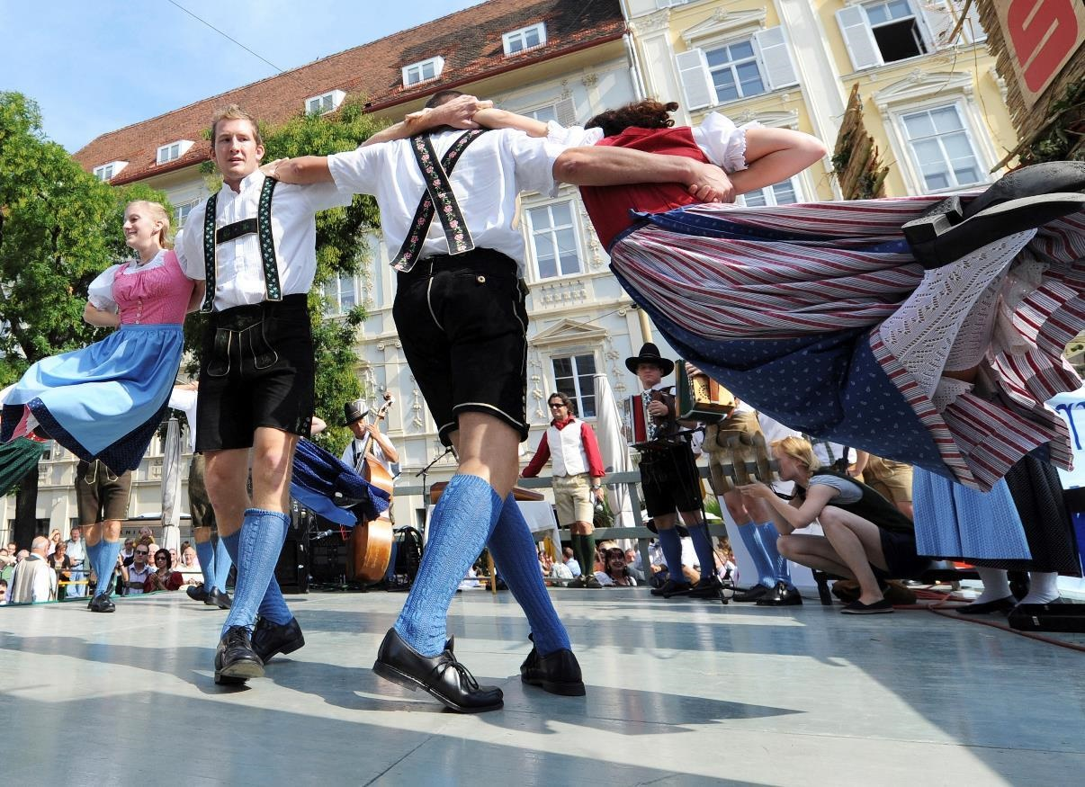
Styria
Rich in tradition & culture
Folklore & culture are
celebrated in town & country:
Cultural enjoyment as an
incentive, company outing or supporting programme
Tradition and customs
harmonise with the modern
and contemporary
Numerous events such as the
Daffodil Festival and cultural highlights from the Lipizzaner horses to the Benedictine Admont Abbey
UNESCO World Heritage Sites and cultural heritage

Slide 17
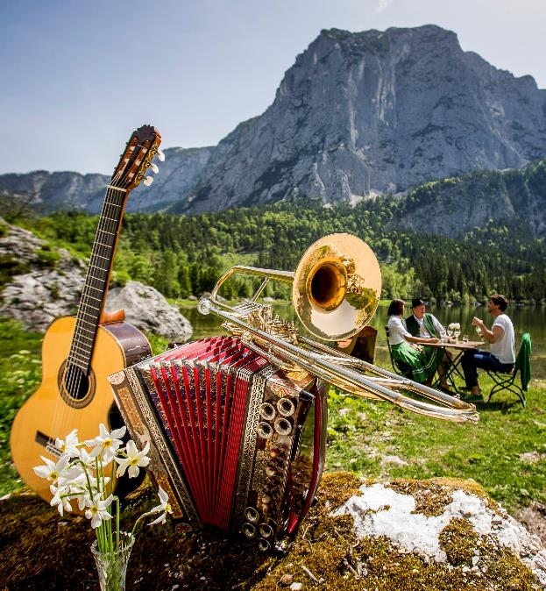
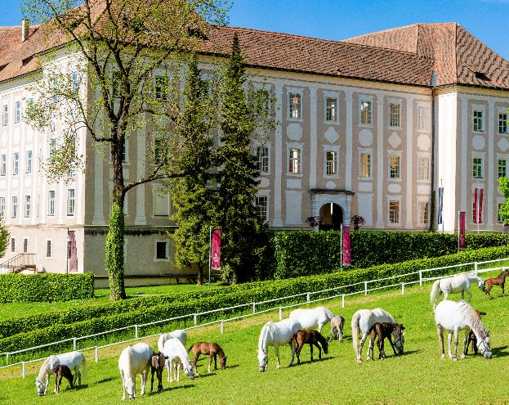
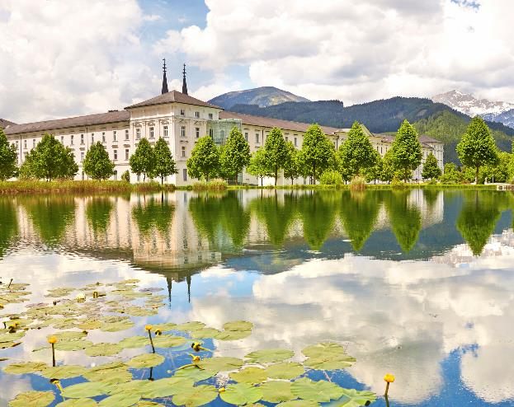
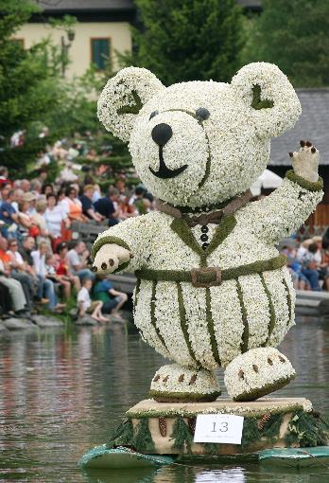
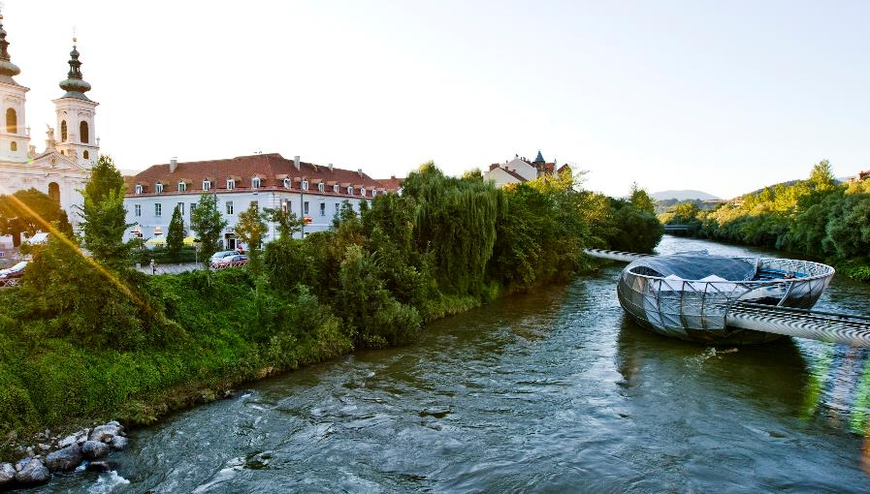
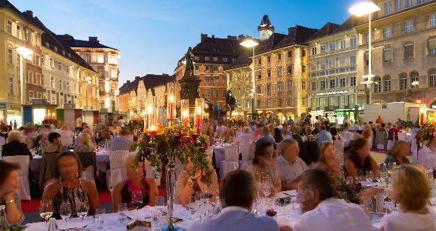

Slide 18
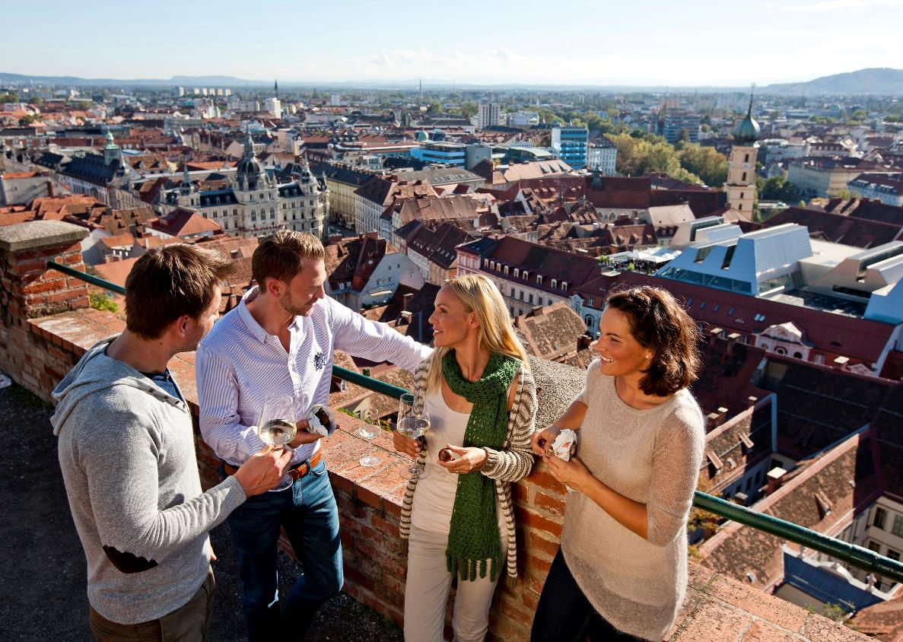
Graz
City of Congress & Design
University city (Med Uni, TU, Main University, Joanneum)
3 congress houses
(capacities up to 5.000 in
one venue)
2 event locations
8 seminar hotels
(capacities up to 250 rooms in one house)
steiermark.com/Convention

Slide 19
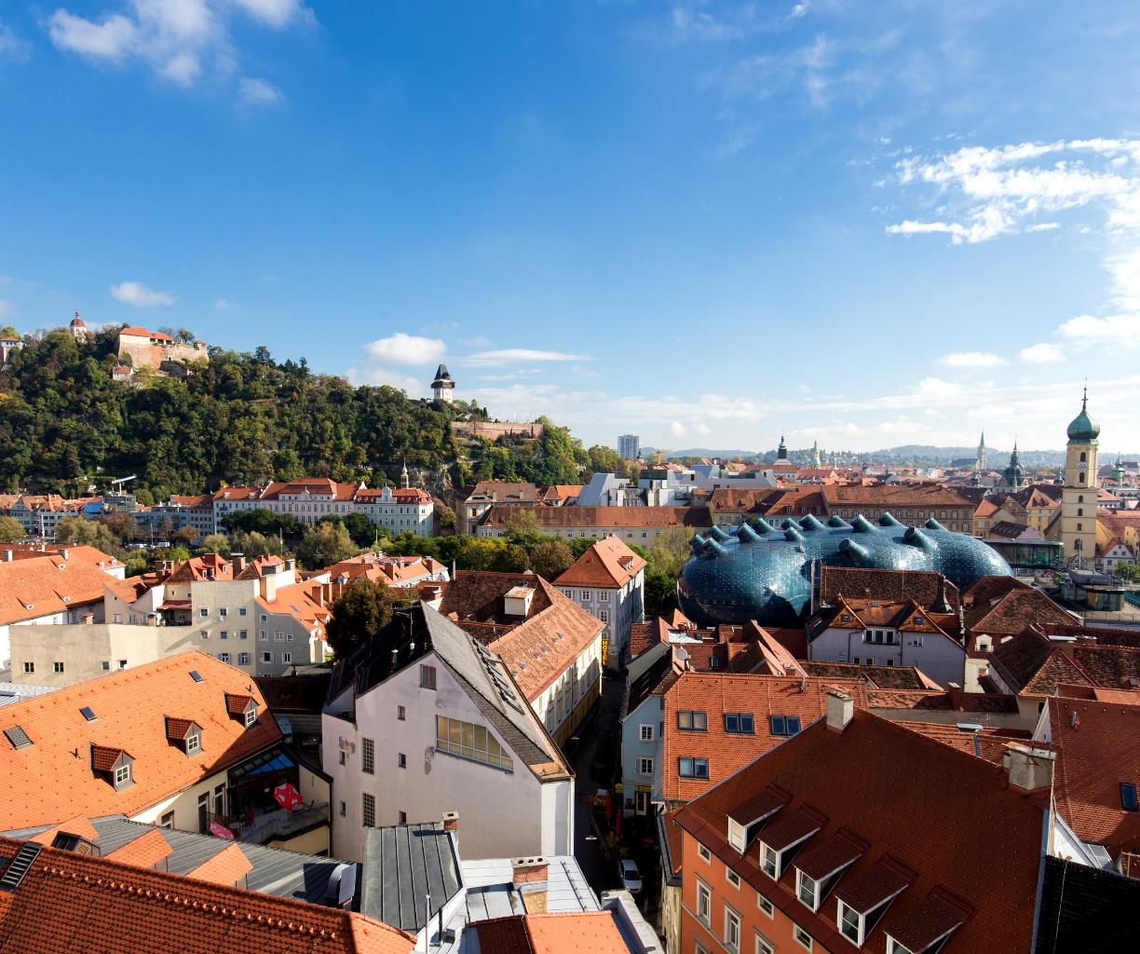
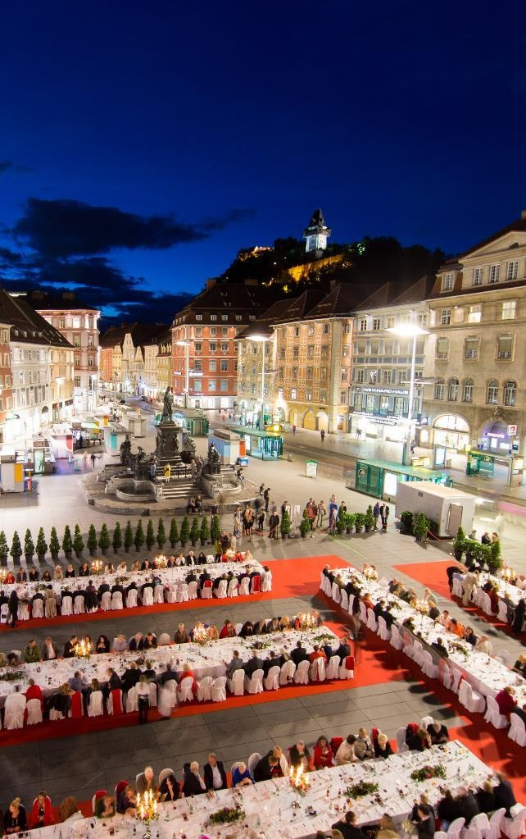
Graz
Capital & City of Design

Slide 20
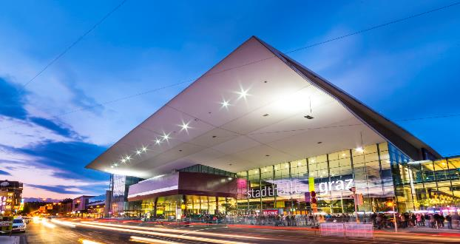
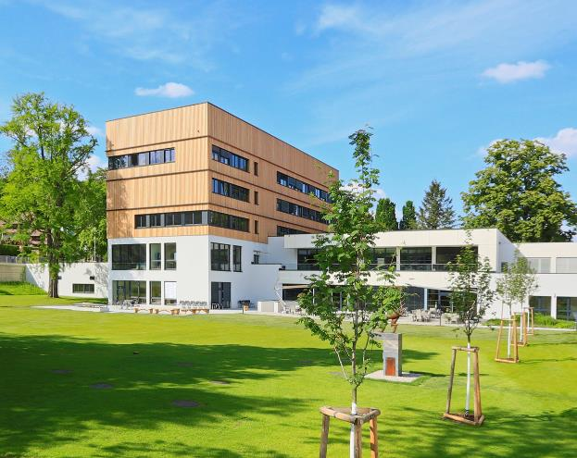
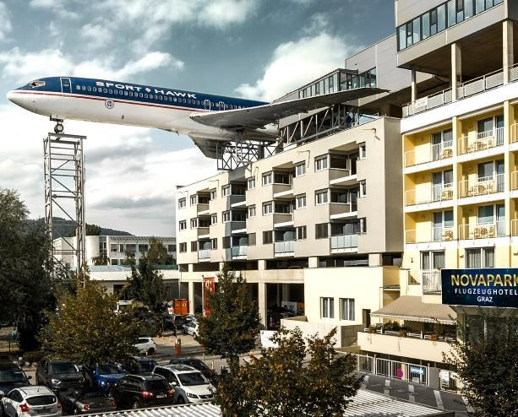
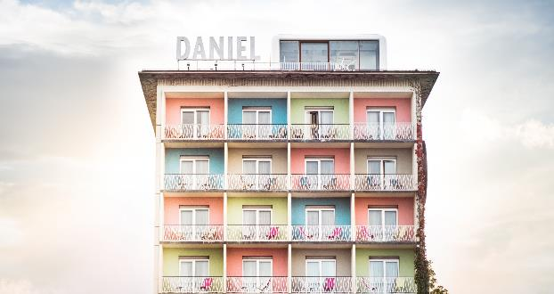
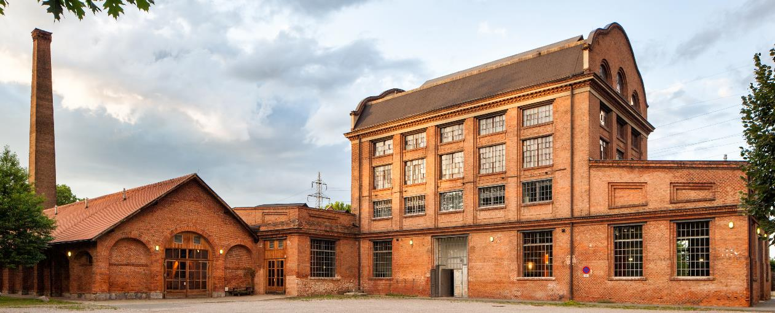
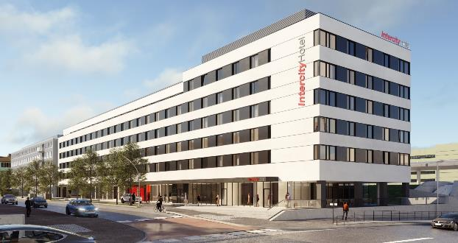

Slide 21
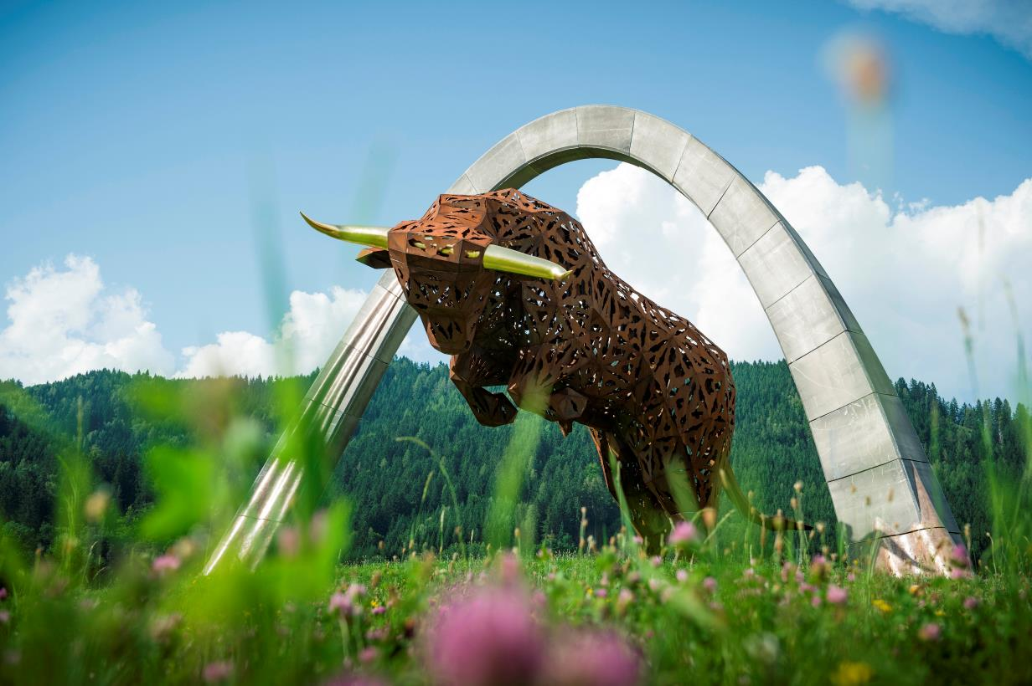
Events
Rich in tradition & culture
F1 Austrian Grand Prix &
Moto GP Österreich
Grand Prix on Red Bull Ring
Night Race
FIS Ski World Cup
Dozens of different traditional festivities like Dafodils- or Narzissenfest in Ausseerland, Weinlese in Southern Styria, Aufsteirern in Graz
steiermark.com/Convention

Slide 22
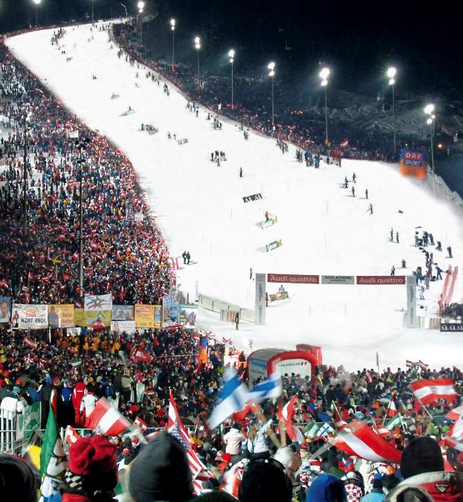
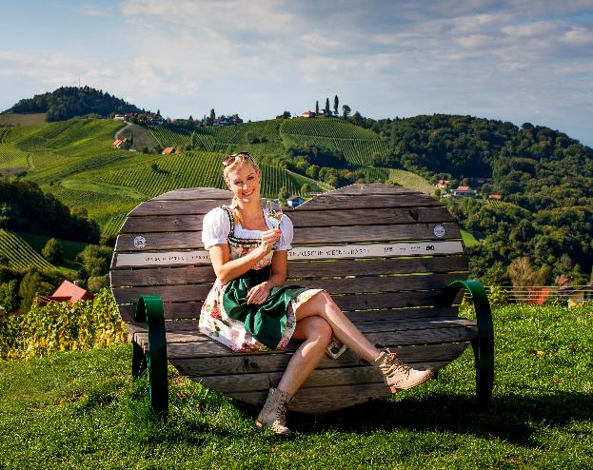
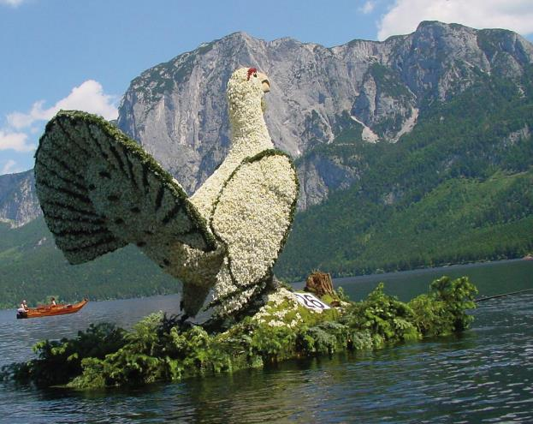
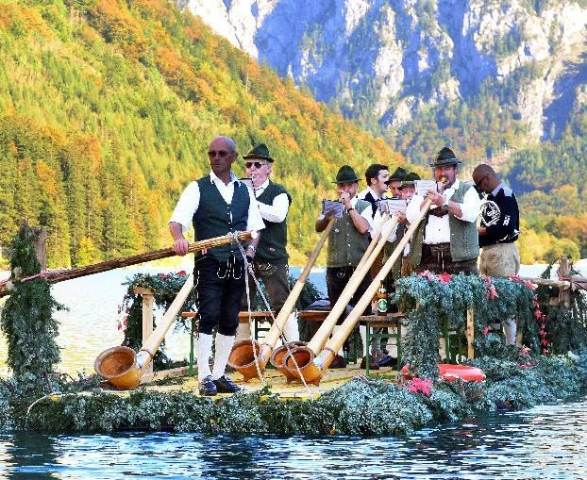



Slide 23


Steiermark Convention
Your MICE-partner since 2003
Our free of cost service:
Support in the selection of suitable conference hotels, event locations,
congress centres and event agencies
Establishing contact with the providers
Recommendation of incentive ideas, business trips and supporting programme
Online venue finder, tailored to the organiser's requirements
Accompaniment
steiermark.com/Convention

Slide 24

Steiermark Convention
Making meetings a delight
See you soon, in
The Green Heart of Austria
T: +43 (0) 3112 38585
Mail to: info@steiermark-convention.com
Homepage: steiermark.com/Convention
Instagram: @steiermarkconvention

